Slide 1
CRYPTOGRAPHY with 8086 Assembly
EP-206 Microprocessors and Interfacing
Aditya Singh 2K19/EP/005 Submitted to: Dr. Rishu Chaujar
Anshul Satija 2K19/EP/018

Slide 2
Table of Contents
Definition and Terminologies
Types of Cryptography and Ciphers
Caesar Cipher
ROT13
Assembly Code

Slide 3

DEFINITION
It is an ancient art and science of writing in secret message.
Cryptography comes from Greek word “crypto “ means hiding and “Graphy” means writing.
It is the art of achieving security by encoding messages to make them non readable.

Slide 4
TERMINOLOGIES
Encryption - It is the process of transforming information so it is unintelligible to anyone but the intended recipient.
Decryption - It is the process of transforming encrypted information so that it is intelligible again.
Plaintext - the message to be transmitted or stored.
Cipher text - the disguised message or encrypted message.
Cipher - Algorithm used for encryption and decryption.

Slide 5
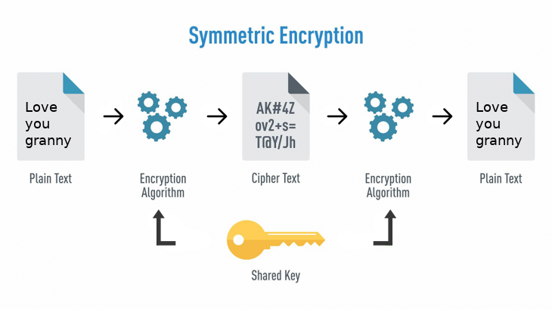
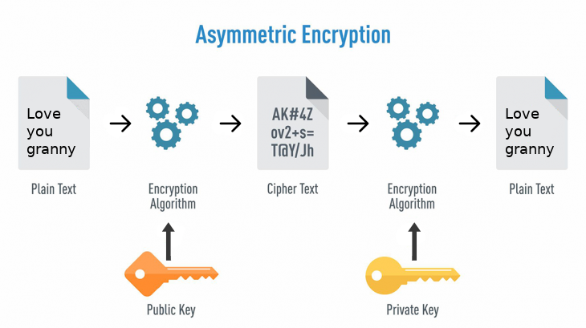
TYPES OF CRYPTOGRAPHY

Slide 6
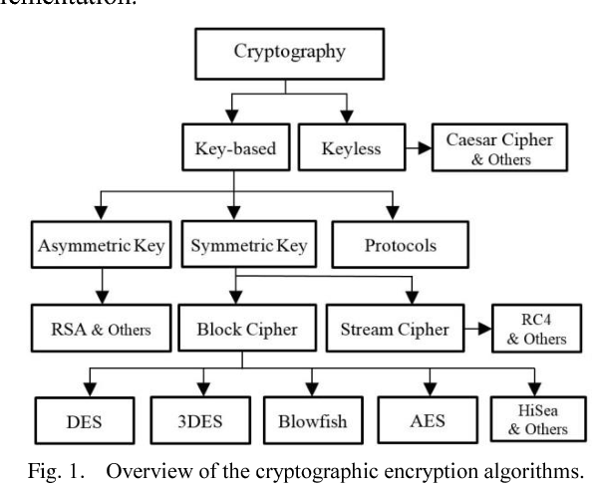

Slide 7
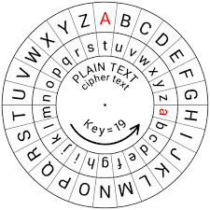
Caesar’s Cipher (Substitution Cipher)
The method is named after Julius Caesar, who used it to communicate with his generals.
It is also known as the shift cipher, Caesar’s code or Caesar shift.
It is one of the simplest and most widely known encryption techniques.
Letter in the plaintext is replaced by a letter some fixed number of positions down the alphabet.

Slide 8
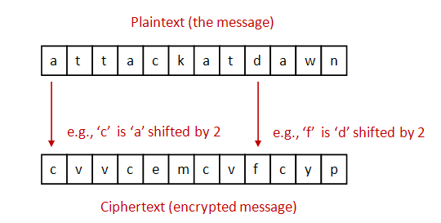
ENCRYPTION OF CAESAR’S TEXT
Encryption of a letter x by a shift n can be described mathematically as,
E_{n}(x) = (x+n) mod 26
Example: Encryption of a letter A by a shift 2 is, E_{n}(x) = (A+2) mod 26 = (0+2) mod 26 = 2
Encrypted letter for A is C

Slide 9
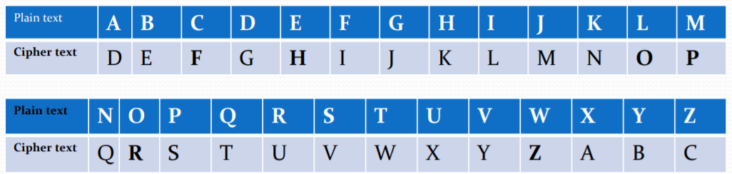
FOR KEY = 3
Plain text is =“WELCOME”
Cipher text is =“ZHOFRPH”

Slide 10
CRYPTANALYSIS
In order to decipher the message, one needs to determine the shift value used. The English alphabet has only 26 characters, which means the key space is 26.
This means the shift value could be any integer between 0 and 26, but since 0 and 26 would result in no change of plaintext it is realistic to consider the possible keys as {1, 2, … , 25}.
Brute force attacks are usually the simplest to implement, but have a very low computational efficiency. This, however, is not so bad in the case where our key space is so small. But requires 26! computations.

Slide 11
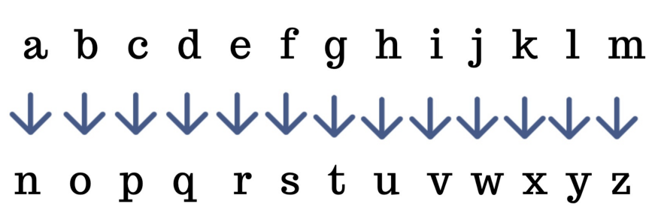
ROT 13
ROT13 cipher(read as – “rotate by 13 places”) is a special case of the Caesar cipher in which the shift is always 13 (i.e. Key = 13).
It is a simple letter substitution cipher that replaces a letter with the 13th letter after it in the alphabet.
As there are 26 letters (2×13), so the same algorithm can be used for encoding and decoding.
ROT13 is used in online forums as a means of hiding spoilers, punchlines, puzzle solutions, and offensive materials from the casual glance.

Slide 12
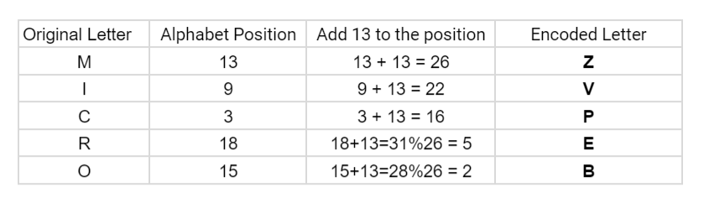
Example :
If a value is greater than 26 than take modulus.

Slide 13
ASSEMBLY PROGRAM (CODE LINK)
The program will print out a prompt, then read an input string from the user. Note that the "read" system call does not null-terminate the input string--therefore must use the returned byte count.
The main body of your program will then loop over the characters in the input string, converting the alphabetic characters to their ROT13 equivalents. All non-alphabetic characters (digits, punctuation symbols, etc.) must be left as-is.
Transformed input characters must be stored in successive memory locations. The program stores all transformed input characters before any characters are output.
The program works for any inputs 'A' through 'Z'. The program does not need to validate inputs, and must then output the translated string.

Slide 14
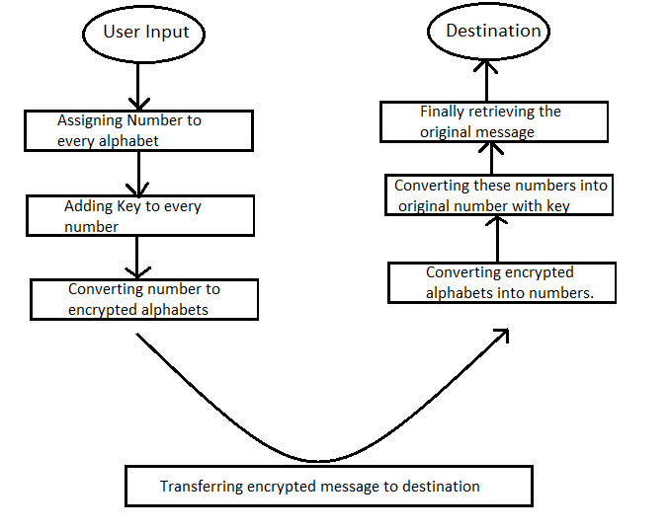
ALGORITHM
FLOW CHART

Slide 15
SCOPE OF FUTURE INNOVATIONS
Nothing in this world is perfect. Everything can be improved in some or the other way, and so is our project.
Future Ideas for project :
The key will be taken from user hence making the method of encryption different for everyone, in this way no one except the user knows the key and only he can crack the encrypted message.
The key can be generated randomly for every word and along with the encrypted message the key for the word will also be sent.
For special characters, a dictionary will be formed for encryption of special characters.

Slide 16
THANK YOU

